Slide 1
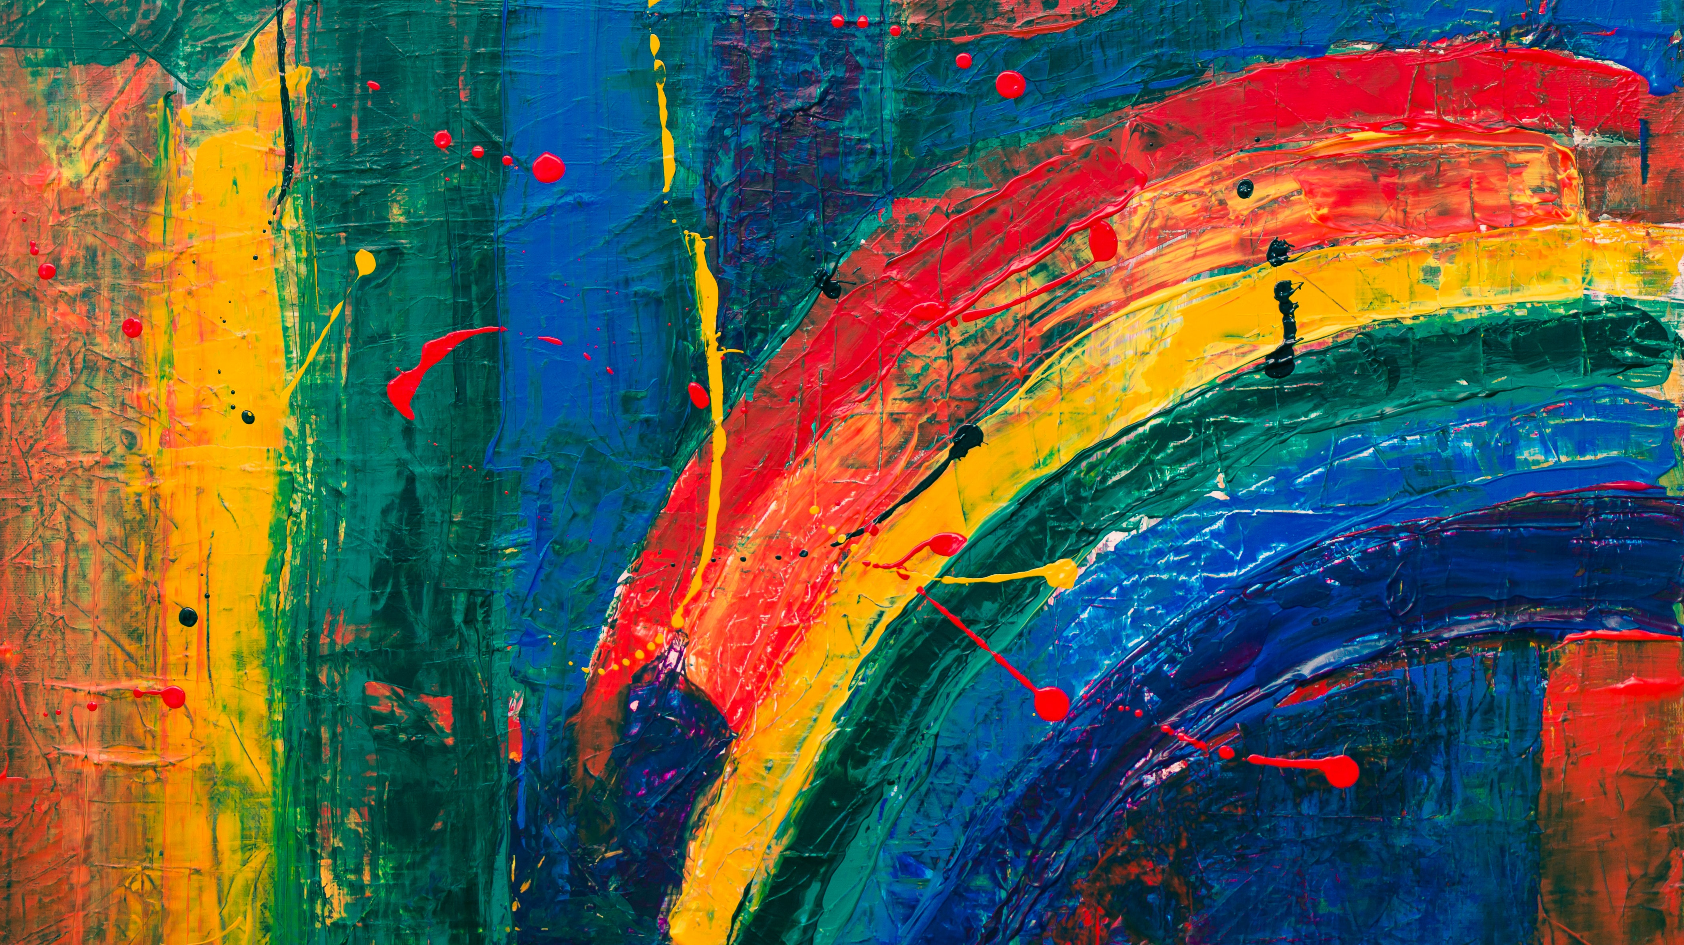
Image Colorization: Using Convolutional Neural Networks

Slide 2
Problem Statement
We aim to infer a full-colored image, which has 3 values per pixel (lightness, saturation, and hue), from a grayscale image, which has only 1 value per pixel (lightness only).
The image intensities(and hence the "Color") is predicted using regression on CNN architectures

Slide 3
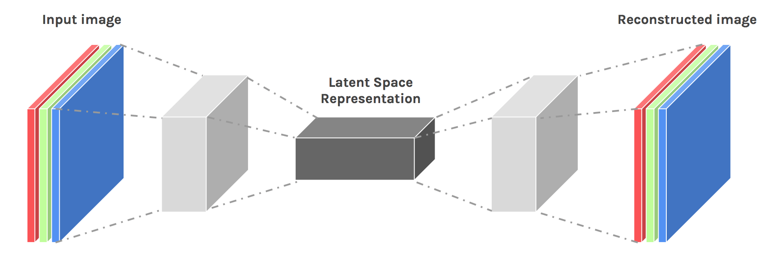
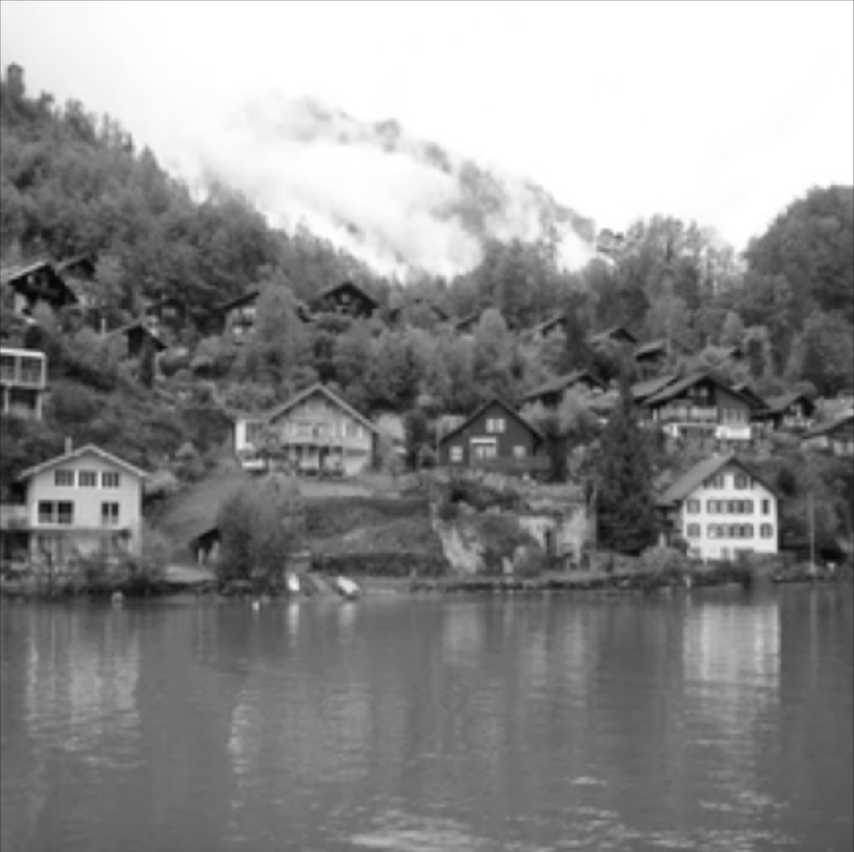
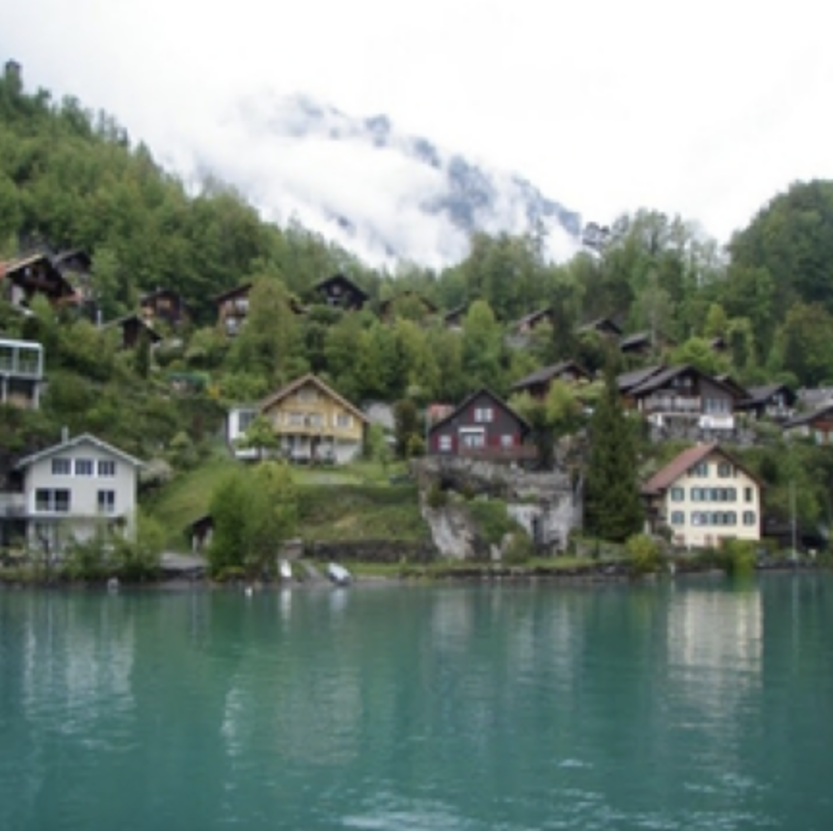
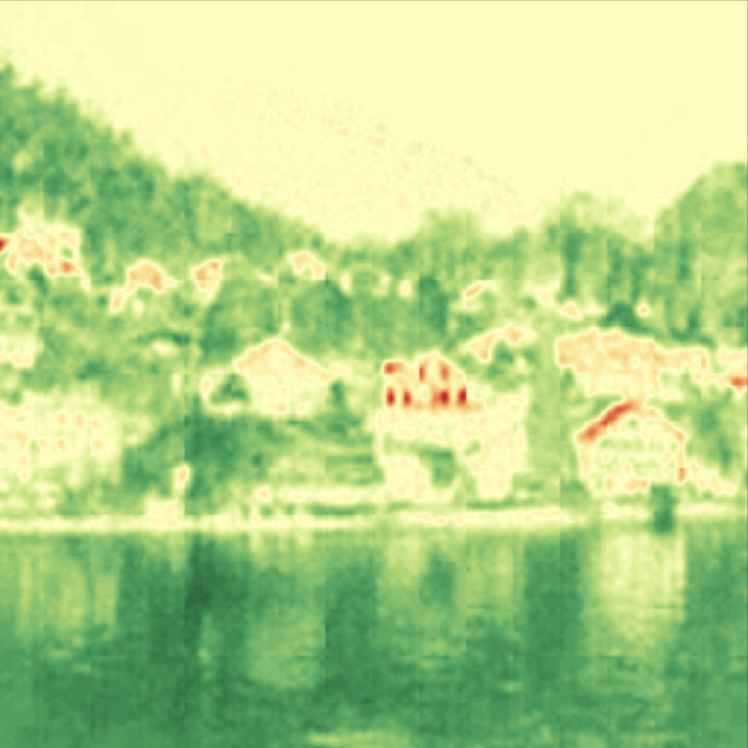
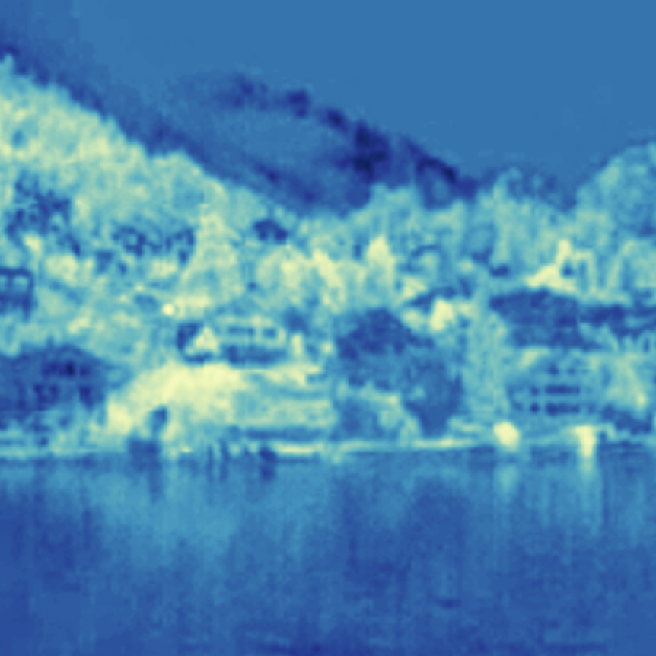
RGB TO LAB
Loss
Back Propagation
Loss

Slide 4
Custom Model
Actual AB Channel
AB Channel
Image
Gray Channel
AB Channel Obtain From CNN
Convolution Layer
Deconvolution Layer

Slide 5
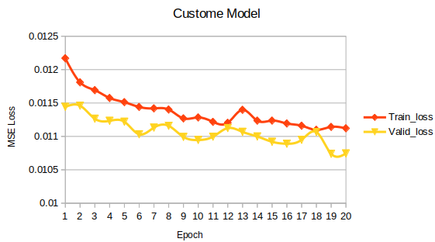
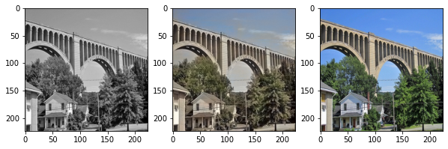
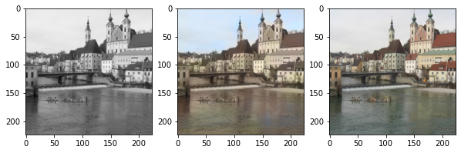
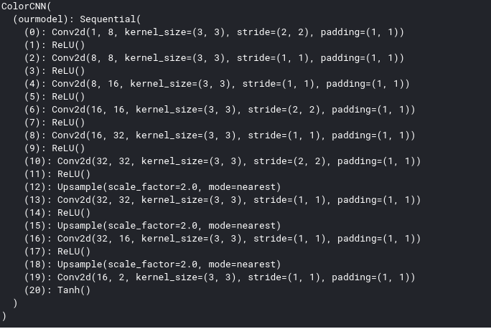
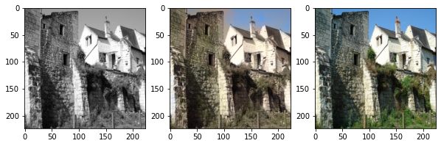
Input Model Prediction Ground Truth

Slide 6
ResNet Model
Actual AB Channel
AB Channel
Image
Gray Channel
AB Channel Obtain From CNN
ResNet-18 First Six Convolution Layer
Deconvolution Layer

Slide 7
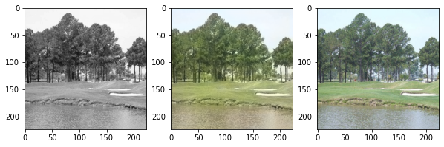
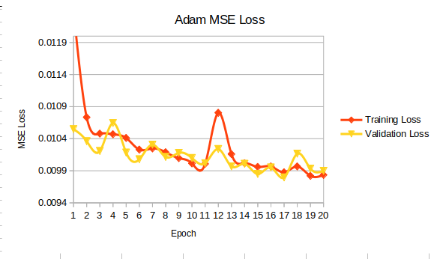
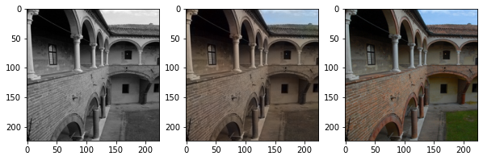
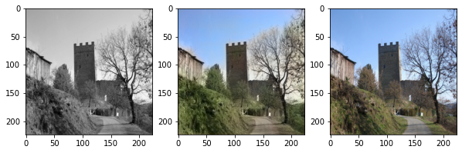
MSE Loss [Adam]
Input Model Prediction Ground Truth
We can observe roughly 10% decrement in MSE loss from out custom model

Slide 8
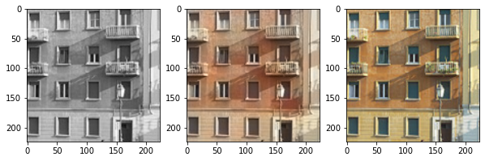
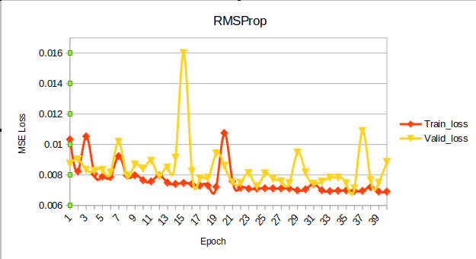
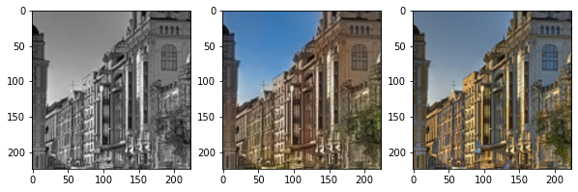
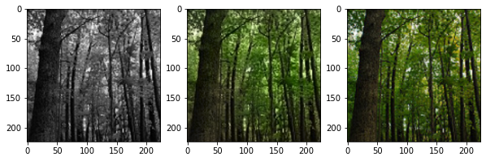
MSE Loss [RMSProp]
Input Model Prediction Ground Truth
We can observe roughly around 36% decrement from custom model and 28% from Adam optimizer

Slide 9
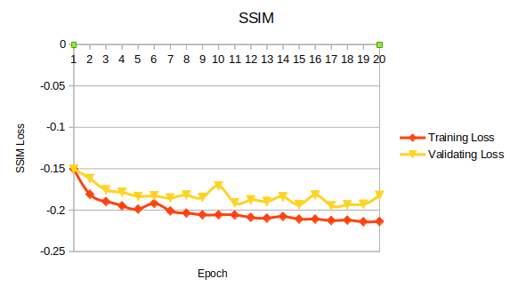
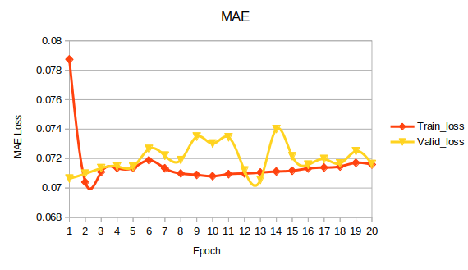
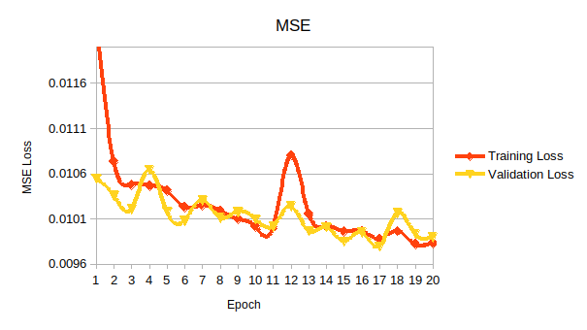
Experiments with different loss functions

Slide 10
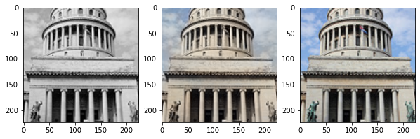
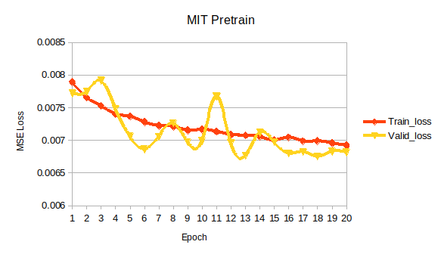
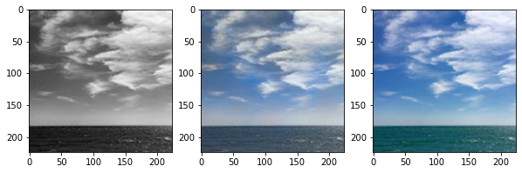
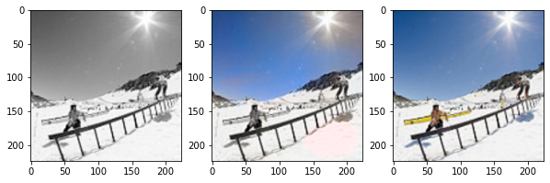
Pretrained on MITPlaces and finetuned on Dataset for Natural Images
Input Model Prediction Ground Truth

Slide 11
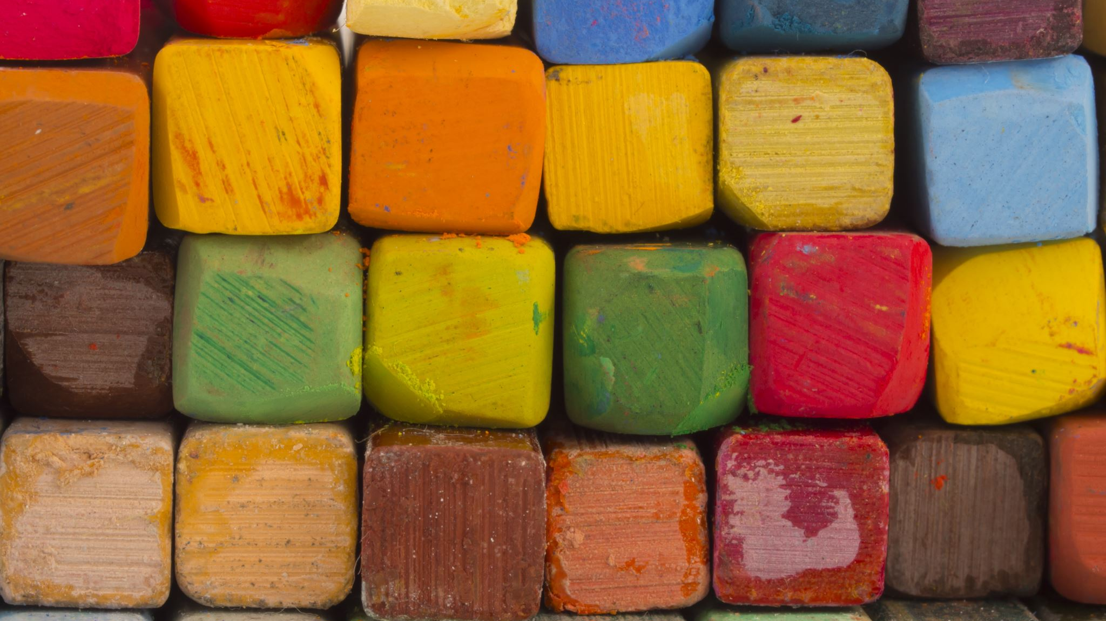
Thank You

